Slide 1
Best practices for community dashboard use – reflections from the HCS study
W05
Naleef Fareed, PhD & Timothy Huerta PhD
The Ohio State University
#IS24

Slide 2
Disclosure
We have no relevant relationships with commercial interests to disclose.

Slide 3
Learning objectives
After participating in this session, the learner should be better able to:
Use a mixed-methods approach to evaluate community dashboard use and usability.
Recognize barriers and facilitators around dashboard use among community members.
Implement best practices on community dashboard use.

Slide 4
CTH dashboard user experience study purpose
Are the CTH dashboards usable and useful for community decision-making?
Are the dashboards easy to use and understand?
Will the dashboards be used in the long-term and for what purpose?

Slide 5
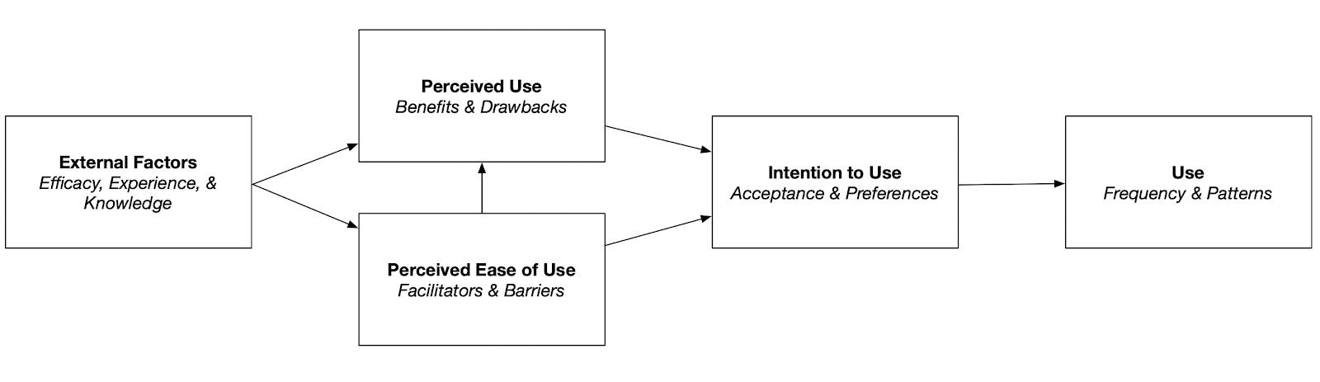
Conceptual model
Technology Acceptance Model (TAM)

Slide 6
Approach
Mixed-methods
Study focused on Wave 1 HCS communities (33 communities across the four research sites)
Semi-structured group and individual interviews with coalition members
Identify common themes about portals across communities
Data collection occurred between June and July 2021
System Usability Survey administered to assess perceived use and usability

Slide 7
Interview and coding
Interview prompted participants to share their thoughts on the usefulness of the CTH portal and experience with using the dashboard
Facilitators probed for clarity or additional detail
Interviews were conducted on Zoom, recorded, and transcribed
Interview lasted ~ 1 hour
Coding based on iterative constant comparative method
Five researchers involved in identification of themes and sub-themes

Slide 8
Sample characteristics
Summary of interview participants and representation
Site | Staff Invited | Coalition Members Invited | Interviewed Staff n (% of invited) | Interviewed Coalition Members n (% of invited) | Total Interviewed n (% of invited) | Urban Interviewed n (% of total interviewed) | Coalition Members Interviewed n (% of total interviewed) | Number of Group Interviews
KY | 6 | 34 | 5 (83) | 8 (24) | 13 (33) | 7 (54) | 8 (62) | 7
MA | 11 | 16 | 10 (91) | 5 (31) | 15 (56) | 10 (67) | 5 (33) | 6
NY | 8 | 17 | 8 (100) | 10 (59) | 18 (72) | 13 (72) | 10 (56) | 7
OH | 7 | 60 | 4 (57) | 12 (20) | 16 (24) | 8 (50) | 12 (75) | 7
Total | 32 | 127 | 27 (84) | 35 (28) | 62 (29) | 38 (61) | 25 (56) | 27

Slide 9
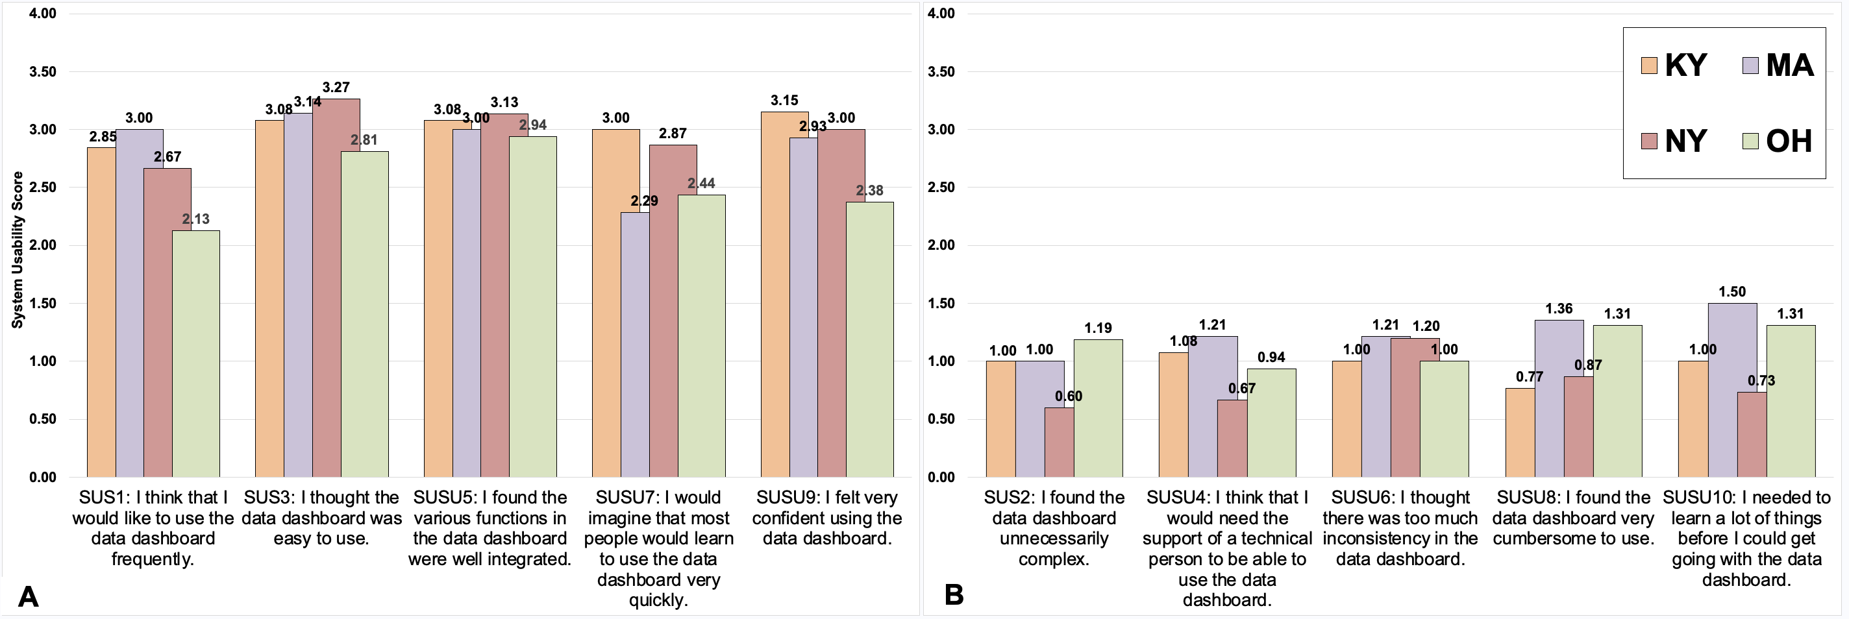
SUS Results
Overall SUS: 73 (SD=4.6; 70th-80th percentile)
“Acceptable Range,” like Amazon and Microsoft Word

Slide 10
TAM Themes

Slide 11
Selection of Positive Remarks
“Yes, I do believe that it definitely helped when it came to those decisions because it helped the entire coalition know certain areas that needed extra help and what kind of help that they needed. It also helped us form... helped us do the problem solving in the original start of this coalition.” (MA)
“It's quick, it's like a bottom line, you know. If you, if you had to throw together a newsletter or a speech or a letter to the editor, you could, you know, you could glance over it and get some up to date, real time numbers, you know, for that area, pretty reliably.” (NY)

Slide 12
Selection of Positive Remarks
“I think it's a terrific dashboard. I love the way that the information is on there. I think it really captures every aspect of what we're seeing on the street.” (OH)
“Because it helped us choose... There's 10 strategies that you could have chose, but by looking at the data that's available on the dashboard, then you say, ‘All right, these are the ones that we need to tackle here in our community, because it's right here in front of our face. These are the important ones.’”(KY)

Slide 13
L1: Utilize storytelling view dashboards and L2: Link actionable insights to useful resources
PG: Cognitive dissonance with the dashboards
“The problem is much bigger than what the numbers from [DEIDENTIFIED AGENCY] can show us and so when we're looking at it that way, it's better to get that real time data from each other rather than rely on HCS to get old data that we've kind of already gone through.” (OH)
Richer storytelling involves multiple iterations of co-creation to craft right set of information that fit with internal mental models of the task and lived experiences.
Dashboards should also link data with a call to action.

Slide 14
L3: Utilize processes and tools that promote access and sharing
PG: Gatekeeping of the data and dashboards
“This might be a little petty, but just the fact that I have to use a password to access it. I think especially people on our coalition, they may not write down their passwords that they use for [HCS] because it's not their full-time job. So. if they forget the password, they're less likely to go through the steps to retrieve it and get in there, so they may not use it as much if it were just open access.” (KY)
Promote permissible sharing to facilitate data sharing and generation of new insights through diverse outlets.

Slide 15
L4: Utilize a multisector and interdisciplinary approach to understand and improve engagement with data visualizations
PG: Low engagement with dashboards
“Something that has been frustrating for me, from some of the HCS data that we get is we get a lot of plots, but we never get the underlying data. And always what I want to do is be able to download it, download it into like visualization software that I use, add those like timeline components, and then present it in a way that I know my community will understand.” (NY)
Comprehensive monitoring of dashboard use should involve quantitative (audit files) and qualitative approaches.
Training, workflow integration, and high-fidelity co-creation are critical components that should also inform engagement.

Slide 16
Concluding Remarks
Our study is idiosyncratic to HCS but is one of the first large-scale evaluations of community dashboard user experience.
Use of the TAM and SUS to examine usability of dashboards among community stakeholders is novel.
Our mixed-methods approach demonstrates the importance of a multifaceted evaluation that can be used to identify gaps in community dashboard use and develop best practices.

Slide 17
Thank you!
Email me at: naleef.fareed@osumc.edu

